Slide 2
Learning Objectives (1 of 2)
Describe information technologies that could be used in computer crimes
Describe basic safeguards in computer and network security
Explain the major security threats
Describe security and enforcement measures

Slide 3
Learning Objectives (2 of 2)
Summarize the guidelines for a comprehensive security system, including business continuity planning

Slide 4
Risks Associated with Information Technologies
Information technologies can be misused to invade users’ privacy and commit computer crimes
You can minimize or prevent many of these risks by installing operating system updates regularly, using antivirus and antispyware software, and using e-mail security features

Slide 5
The Costs of Cyber Crime to the U.S. Economy
Costs include:
Stolen identities, intellectual property, and trade secrets
Damage done to companies’ and individuals’ reputations
Expense of enhancing and upgrading a company’s network security after an attack
Opportunity costs associated with downtime and lost trust and loss of sensitive business information

Slide 6
Spyware and Adware
Spyware
Software that secretly gathers information about users while they browse the Web
Prevented by installing antivirus or antispyware software
Adware
Spyware that collects information about the user to determine advertisements to display
Prevented by installing an ad-blocking feature in the Web browser

Slide 7
Phishing, Pharming, Baiting, Quid Pro Quo, SMiShing, and Vishing (1 of 3)
Phishing
Sending fraudulent e-mails that seem to come from legitimate sources
Pharming
Internet users are directed to fraudulent Web sites with the intention of stealing their personal information

Slide 8
Phishing, Pharming, Baiting, Quid Pro Quo, SMiShing, and Vishing (2 of 3)
Baiting
Similar to phishing attacks; baiter gives recipient a promise
Quid pro quo
Involves a hacker requesting the exchange of critical data or login information in exchange for a service or prize

Slide 9
Phishing, Pharming, Baiting, Quid Pro Quo, SMiShing, and Vishing (3 of 3)
SMiShing (SMS phishing)
Technique tricks a user to download a malware
Vishing (voice or VoIP phishing)
Technique tricks a user to reveal important financial or personal information to unauthorized entities

Slide 10
Keystroke Loggers
Monitor and record keystrokes
Can be software or hardware devices
Used by companies to track employees’ use of e-mail and the Internet
Used for malicious purposes
Prevented by some antivirus and antispyware programs

Slide 11
Sniffing and Spoofing
Sniffing
Capturing and recording network traffic
Used by hackers to intercept information
Spoofing
Attempting to gain access to a network by posing as an authorized user in order to find sensitive information
Also happens when an illegitimate program poses as a legitimate one

Slide 12
Computer Crime and Fraud (1 of 2)
Computer fraud
Unauthorized use of computer data for personal gain
Computer crimes
Denial-of-service attacks
Identity theft and software piracy
Distributing child pornography
E-mail spamming
Writing or spreading malicious codes

Slide 13
Computer Crime and Fraud (2 of 2)
Stealing files for industrial espionage
Changing computer records illegally
Virus hoaxes
Sabotage
Holding a firm’s critical data for ransom
Example: ransomware

Slide 14
Computer and Network Security: Basic Safeguards (1 of 5)
Comprehensive security system
Protects an organization’s resources
Collectively protect information resources and keep intruders and hackers at bay
Hardware
Software
Procedures
Personnel

Slide 15
Computer and Network Security: Basic Safeguards (2 of 5)
Important aspects of computer and network security: CIA triangle
Confidentiality
Integrity
Availability

Slide 16
Computer and Network Security: Basic Safeguards (3 of 5)
McCumber cube
Framework for evaluating information security
Represented as a three-dimensional cube
Defines nine characteristics of information security
Includes different states in which information can exist in a system
Transmission, storage, and processing

Slide 17
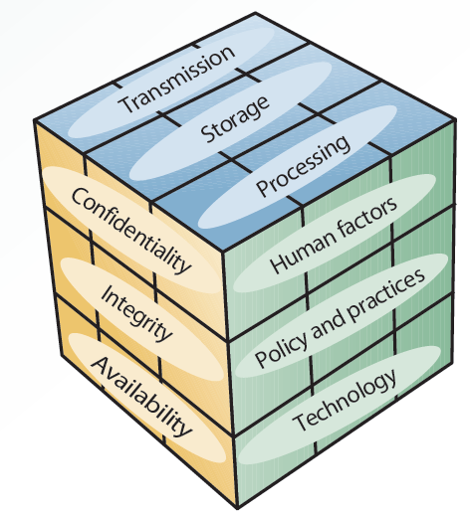
5.1 McCumber Cube

Slide 18
Computer and Network Security: Basic Safeguards (4 of 5)
Levels of network security
Level 1: front-end servers
Protected against unauthorized access
Level 2: back-end systems
Protected to ensure data confidentiality, accuracy, and integrity
Level 3: corporate network
Protected against intrusion, denial-of-service attacks, and unauthorized access

Slide 19
Computer and Network Security: Basic Safeguards (5 of 5)
Planning a comprehensive security system: designing fault-tolerant systems
Ensure availability in the event of a system failure by using a combination of hardware and software
Commonly used methods
Uninterruptible power supply (UPS)
Redundant array of independent disks (RAID)
Mirror disks

Slide 20
Intentional Threats
Intentional threats include:
Viruses and worms
Trojan programs
Logic bombs
Backdoors
Blended threats
Rootkits
Denial-of-service attacks
Social engineering

Slide 21
Viruses
Consists of self-propagating program code that is triggered by a specified time or event
Attaches itself to other files, and the cycle continues when the program or operating system containing the virus is used
Transmitted through a network or e-mail attachments, or message boards
Prevented by installing and updating an antivirus program

Slide 22
Worms
Independent programs that can spread themselves without having to be attached to a host program
Replicate into a full-blown version that could end up eating computing resources
Examples: Code Red, Melissa, and Sasser

Slide 23
Trojan Programs
Contain code intended to disrupt a computer, network, or Web site
Hidden inside a popular program

Slide 24
Logic Bombs
Type of Trojan program used to release a virus, worm, or other destructive code
Triggered at a certain time or by a specific event

Slide 25
Backdoors
Programming routine built into a system by its designer or programmer
Enables the designer or programmer to bypass security and sneak back into the system later to access programs or files

Slide 26
Blended Threats
Combines characteristics of viruses, worms, and malicious codes with vulnerabilities on networks
Search for vulnerabilities in computer networks and take advantage of them
Embedding malicious codes in the server’s HTML files
Sending unauthorized e-mails from compromised servers with a worm attachment

Slide 27
Denial-of-Service Attacks (1 of 2)
Flood a network or server with service requests to prevent legitimate users’ access to the system
Distributed denial-of-service (DDoS) attack: thousands of computers work together to bombard a Web site with thousands of requests in a short period, causing it to grind to a halt

Slide 28
Denial-of-Service Attacks (2 of 2)
Botnet: network of computers and IoT devices:
Infected with malicious software
Controlled as a group without owners’ knowledge
TDoS (telephony denial of service) attacks
Use high volumes of automated calls to tie up a target phone system, halting incoming and outgoing calls

Slide 29
Social Engineering
Using "people skills" to trick others into revealing private information
Commonly used social-engineering techniques
Dumpster diving
Shoulder surfing
Tailgating
Scareware
Pretexting

Slide 30
Security Measures And Enforcement: An Overview
Components of a comprehensive security system
Biometric, nonbiometric, and physical security measures
Access controls
Virtual private networks
Data encryption
E-commerce transaction security measures
Computer Emergency Response Team (CERT)

Slide 31
Biometric Security Measures
Use a physiological element unique to a person that cannot be stolen, lost, copied, or passed on to others
Biometric devices and measures
Facial recognition, fingerprints, hand geometry, iris analysis, palm prints, retinal scanning, signature analysis, vein analysis, and voice recognition

Slide 32
Nonbiometric Security Measures
Three main nonbiometric security measures
Callback modems
Firewalls
Intrusion detection systems

Slide 33
Callback Modems
Verify whether a user’s access is valid
Done by logging the user off and then calling the user back at a predetermined number
Useful when many employees work off-site and need to connect to the network from remote locations

Slide 34
Firewalls
Combinations of hardware and software that acts as a filter between a private network and external networks
Network administrator defines rules for access, and all other data transmissions are blocked
Types: packet-filtering firewalls, application-filtering firewalls, and proxy servers

Slide 35
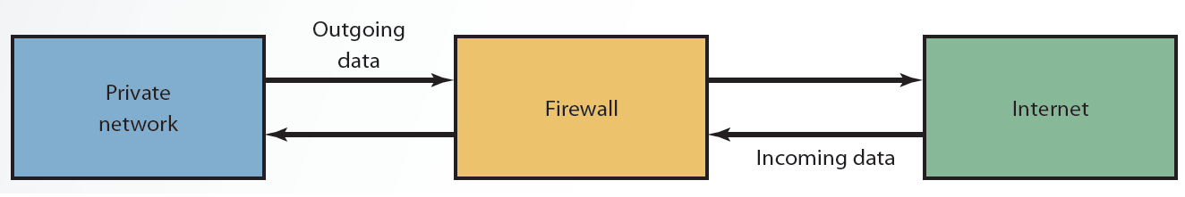
5.3 Basic Firewall Configuration

Slide 36
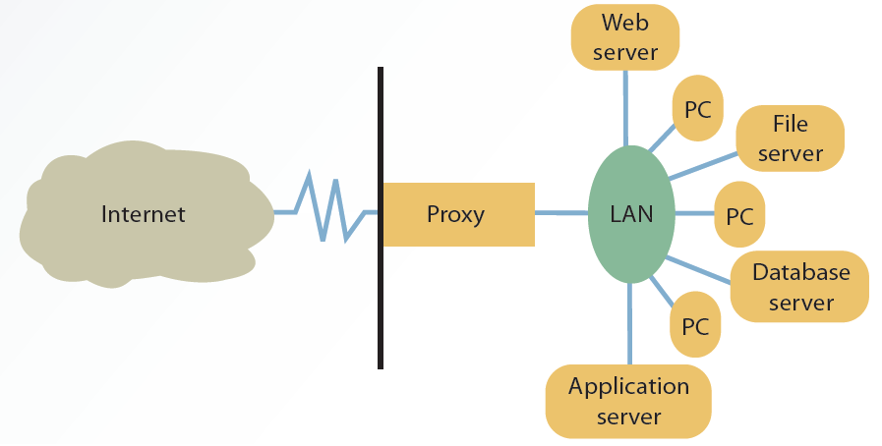
5.4 Proxy Server

Slide 37
Intrusion Detection System (IDS)
Protects against external and internal access
Placed in front of a firewall
Identifies attack signatures, traces patterns, and generates alarms for the network administrator
Causes routers to terminate connections with suspicious sources
Prevents DoS attacks

Slide 38
Physical Security Measures
Control access to computers and networks
Include devices for securing computers and peripherals from theft
Cable shielding and room shielding
Corner bolts and steel encasements
Electronic trackers, identification (ID) badges, and proximity-release door openers

Slide 39
Access Controls
Designed to protect systems from unauthorized access in order to preserve data integrity
Terminal resource security: erases the screen and signs the user off automatically after a specified length of inactivity
Passwords: combination of numbers, characters, and symbols that is entered to allow access to a system

Slide 40
Virtual Private Networks (1 of 2)
Provides a secure tunnel through the Internet for transmitting messages and data via a private network
Gives remote users have a secure connection to the organization’s network
Provides security for extranets

Slide 41
Virtual Private Networks (2 of 2)
Data is encrypted before it is sent with a protocol
Layer Two Tunneling Protocol (L2TP)
Internet Protocol Security (IPSec)
Advantage
Set-up costs are low
Disadvantages
Slow transmission speed
Lack of standardization

Slide 42
Data Encryption (1 of 4)
Transforms data, called plaintext or cleartext, into a scrambled form called ciphertext that cannot be read by others
Receiver unscrambles data using a decryption key
Rules for encryption
Known as the encryption algorithm
Determine how simple or complex the transformation process should be

Slide 43
Data Encryption (2 of 4)
Commonly used encryption protocols
Secure Sockets Layer (SSL)
Manages transmission security on the Internet
Transport Layer Security (TLS)
Cryptographic protocol that ensures data security and integrity over public networks, such as the Internet

Slide 44
Data Encryption (3 of 4)
Asymmetric encryption uses two keys
Public key known to everyone
Encrypted message can be decrypted only with the same algorithm used by the public key and requires the recipient’s private key
Private or secret key known only to the recipient
Drawback: slow and requires a large amount of processing power

Slide 45
Data Encryption (4 of 4)
Symmetric (secret key) encryption: same key is used to encrypt and decrypt the message
Sender and receiver must agree on the key and keep it secret
Can be used to create digital signatures
Drawback: sharing the key over the Internet is difficult

Slide 46
E-Commerce Transaction Security Measures
Concerned with several issues
Confidentiality
Authentication
Integrity
Nonrepudiation of origin
Nonrepudiation of receipt

Slide 47
Computer Emergency Response Team
Developed by the Defense Advanced Research Projects Agency
Focuses on security breaches and DoS attacks
Offers guidelines on handling and preventing attacks
Conducts public awareness campaigns and researches Internet security vulnerabilities

Slide 48
Guidelines for a Comprehensive Security System (1 of 4)
Before establishing a security program, organizations should:
Understand the principles of the Sarbanes-Oxley Act of 2002
Conduct a basic risk analysis, which makes use of financial and budgeting techniques
Information obtained helps organizations weigh the cost of a security system

Slide 49
Guidelines for a Comprehensive Security System (2 of 4)
Steps when developing a comprehensive security plan
Set up a security committee
Post security policy in a visible place
Raise employee awareness
Use strong passwords
Install software patches and updates
Revoke terminated employees’ passwords and ID badges immediately

Slide 50
Guidelines for a Comprehensive Security System (3 of 4)
Keep sensitive data locked in secured locations
Exit programs and systems promptly
Limit computer access to authorized personnel only
Compare communication logs with communication billings periodically
Install antivirus programs, firewalls, and intrusion detection systems
Use only licensed software

Slide 51
Guidelines for a Comprehensive Security System (4 of 4)
Ensure fire protection systems and alarms are up to date, and test them regularly
Check environmental factors
Temperature and humidity levels
Use physical security measures
Corner bolts on workstations, ID badges, and door locks

Slide 52
Business Continuity Planning (1 of 2)
Outlines procedures for keeping a firm operational in the event of a natural disaster or network attack
Disaster recovery plan lists the tasks that must be performed to restore damaged data and equipment and steps to prepare for disaster

Slide 53
Business Continuity Planning (2 of 2)
Steps to follow when disaster strikes
Put together a management crisis team
Contact the insurance company
Restore phone communication systems
Notify all affected people that recovery is underway
Set up a help desk to assist affected people
Document all actions taken

Slide 54
Summary (1 of 2)
Risks associated with information technologies can be minimized by:
Installing operating system updates regularly
Using antivirus/antispyware software and e-mail security features
Comprehensive security system protects an organization’s resources
Including information, computers, and network equipment

Slide 55
Summary (2 of 2)
Network security threats can be categorized
Unintentional: natural disasters, accidental deletion of data, and structural failures
Intentional: hacker attacks and attacks by disgruntled employees
Organizations must employ a variety of comprehensive security measures to guard against threats

